Slide 1
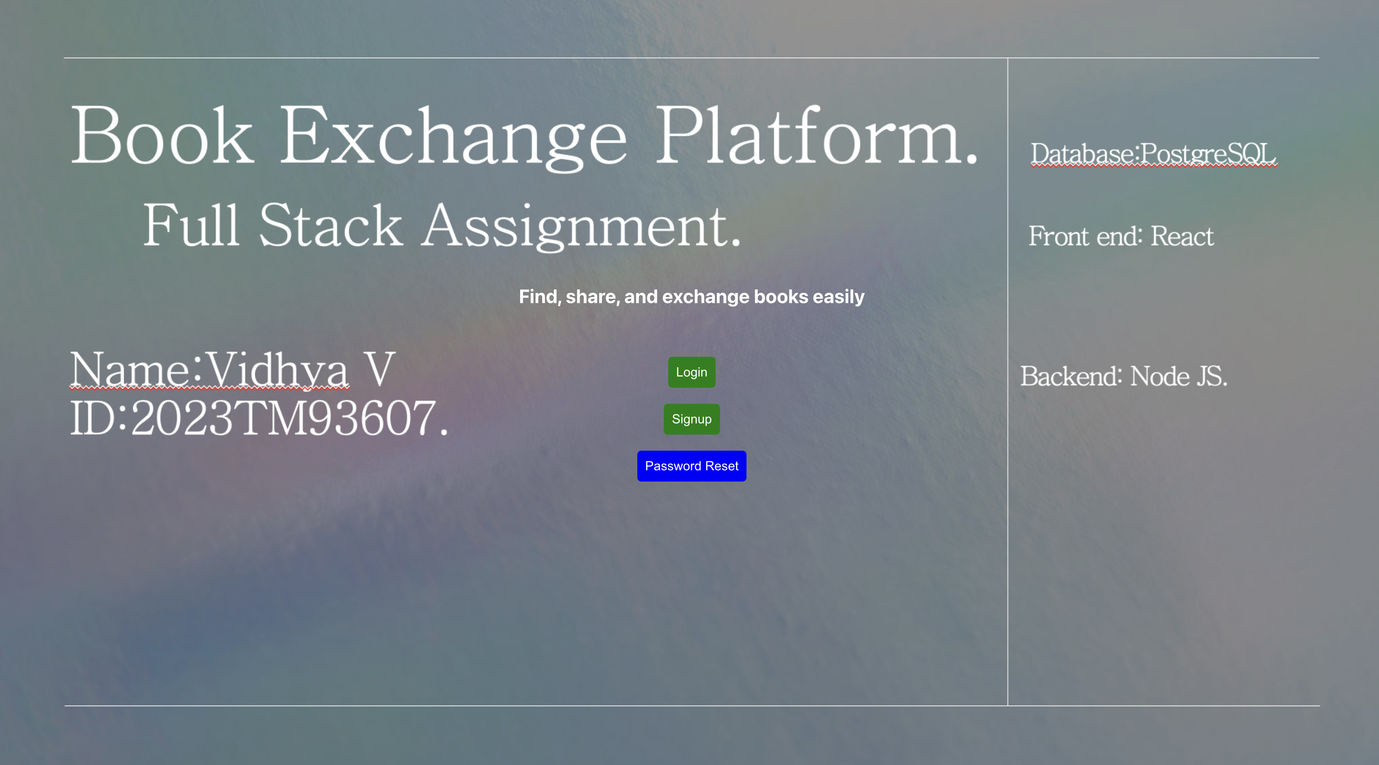

Slide 2

Project Overview
Purpose: To create an online platform that enables users to exchange books, promoting community sharing and access to diverse books.
Objectives:Facilitate user-to-user book exchanges.
Provide a seamless, intuitive interface for searching and listing books.
Ensure data consistency, security, and scalability.

Slide 3

Technology Stack
Frontend: React Reason: React's component-based structure allows for reusable, modular UI elements, making it easier to update and maintain. It’s widely supported, has a large community, and enables rapid development.
Backend: Node.js and Express Reason: Node.js provides asynchronous, non-blocking operations ideal for scalable applications. Express.js simplifies routing, request handling, and integrates seamlessly with React.
Database: PostgreSQL Reason: PostgreSQL is a robust, open-source relational database that provides strong data integrity, advanced querying, and scalability options. It’s well-suited for handling complex data relationships in a book exchange app.

Slide 4
User Stories Implemented
User Authentication | Book Listing | Book Search
User Story 1: User Authentication As a user , I want to securely register, log in, and manage my account, So that I can access and use the book exchange platform. Acceptance Criteria: The platform must allow users to register with a valid email and password. Passwords must be stored securely using encryption. Users should be able to reset their password via a password recovery system. Users should be able to log out from their account. | User Story 2: Book Listing: As a user, I want to list books that I want to exchange or lend, So that others can browse and request the books I offer. Acceptance Criteria: Users should be able to add a book to their list by providing details such as title, author, genre, condition, and availability status. Each book listing must have a unique ID associated with a user’s profile. Users should be able to edit or delete book listings at any time. The book listing must be displayed in the user's profile and searchable by others. | User Story 3: Book Search As a user, I want to search for books based on criteria such as title, author, genre, and location, So that I can easily find books that interest me Acceptance Criteria: The platform must provide a search bar where users can enter keywords like title, author, or genre. The platform should allow users to filter search results by availability status, genre, and location. Users must be able to view detailed information about a book (title, author, condition, etc.) when clicking on a search result. The search results should be paginated or load incrementally to handle large datasets.

Slide 5
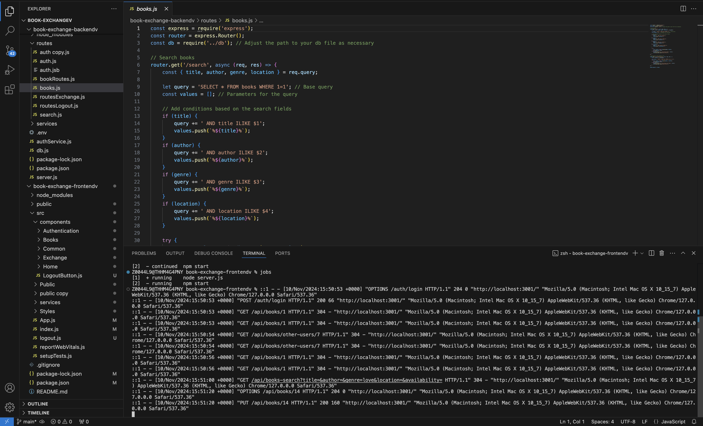

Slide 6
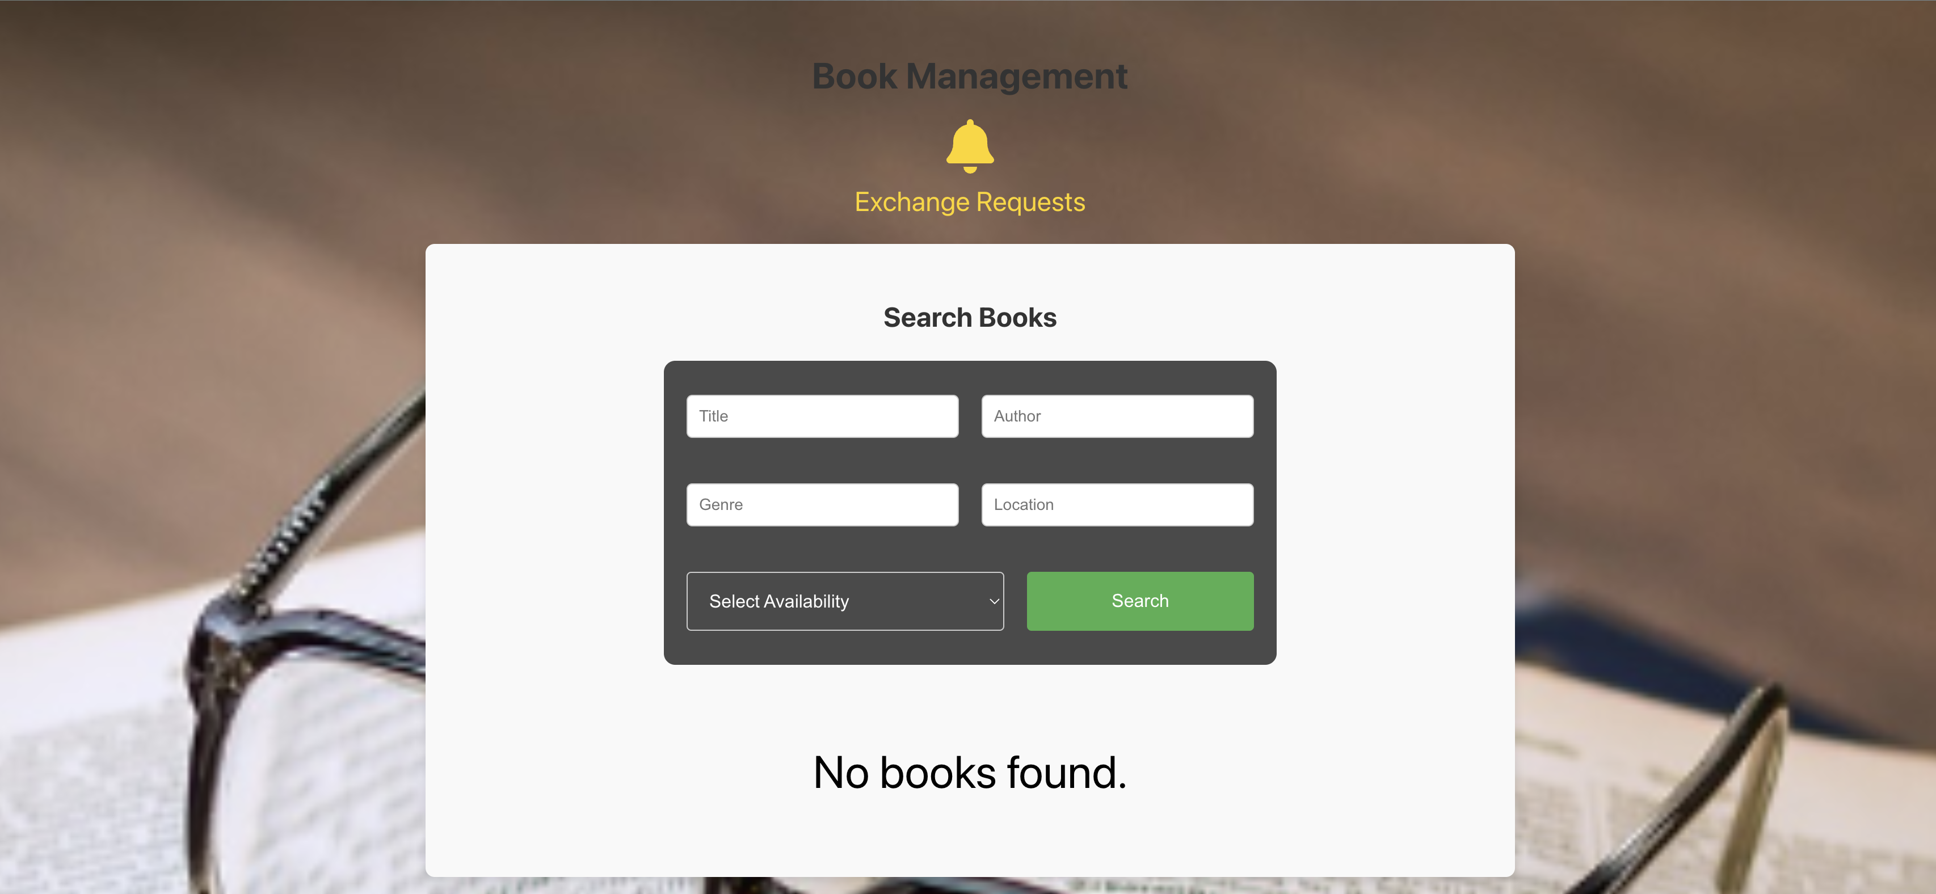
Snapshots of UI Search Book

Slide 7
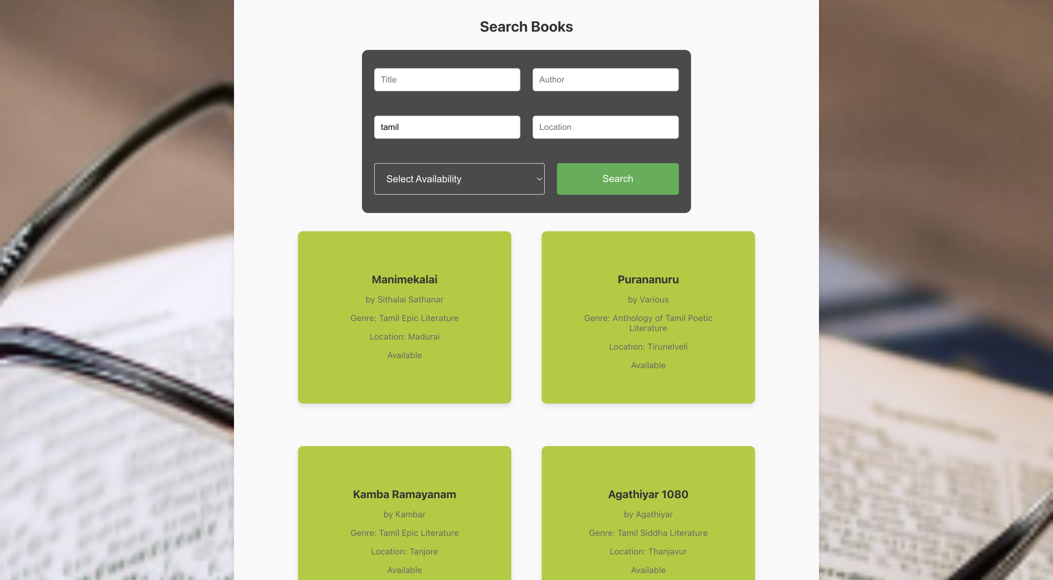
Snapshots of UI Search Results

Slide 8
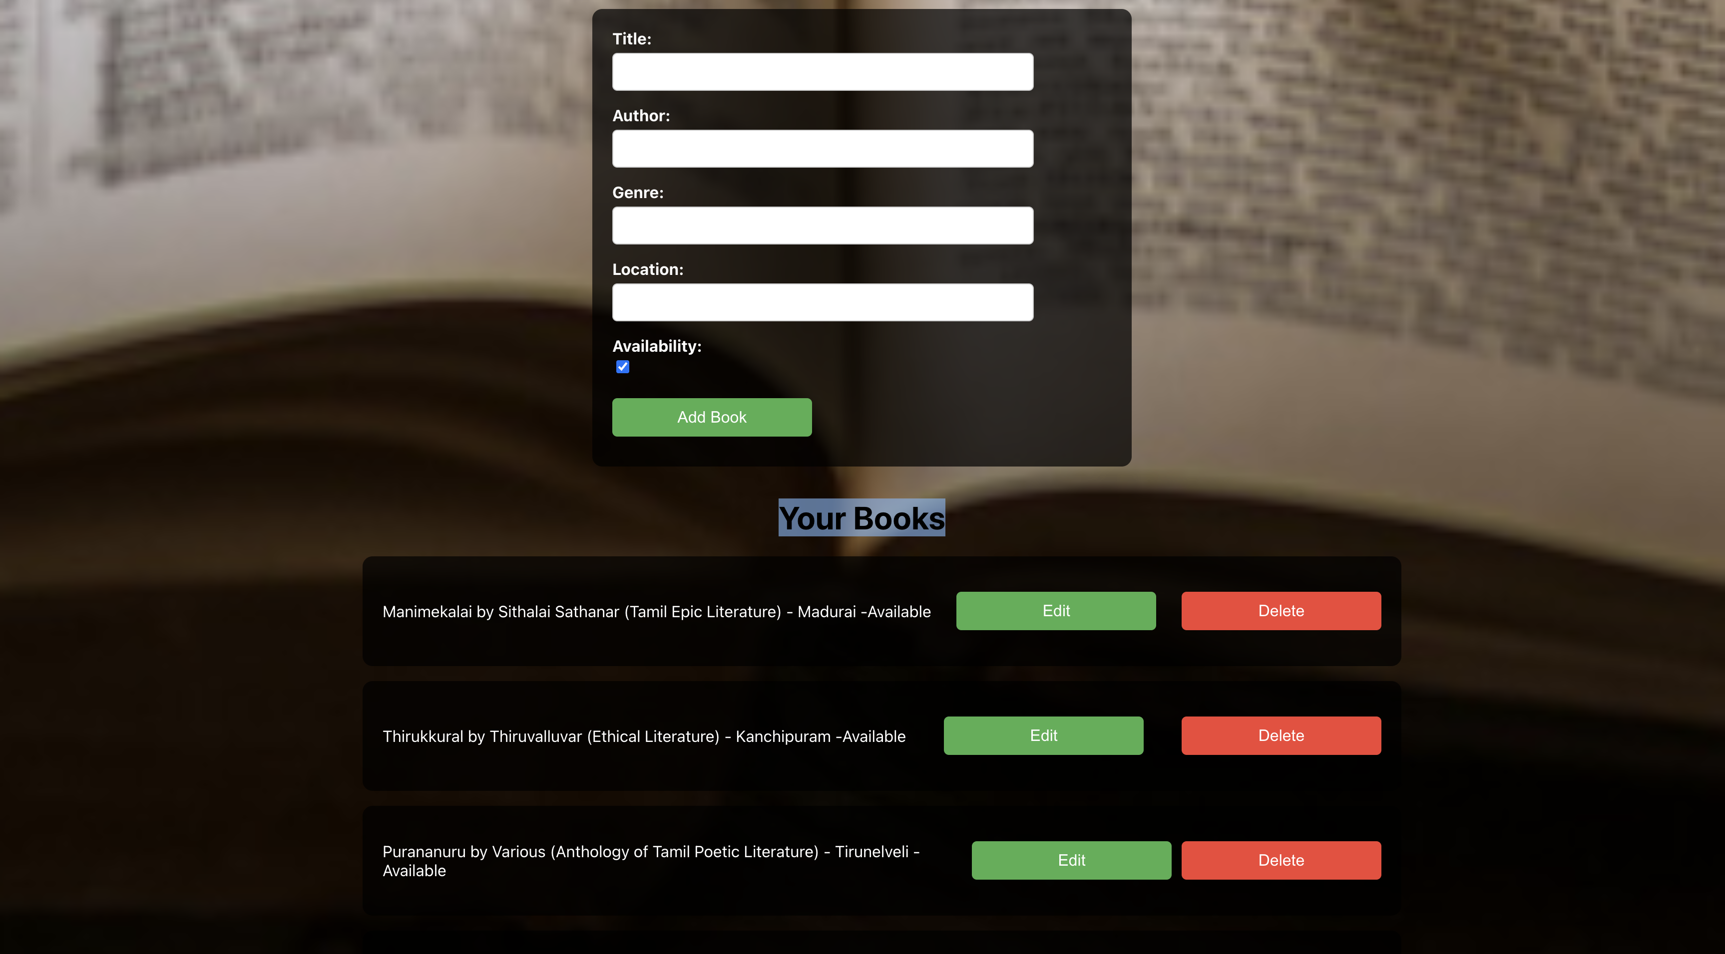
Add Books, Users Existing Book

Slide 9
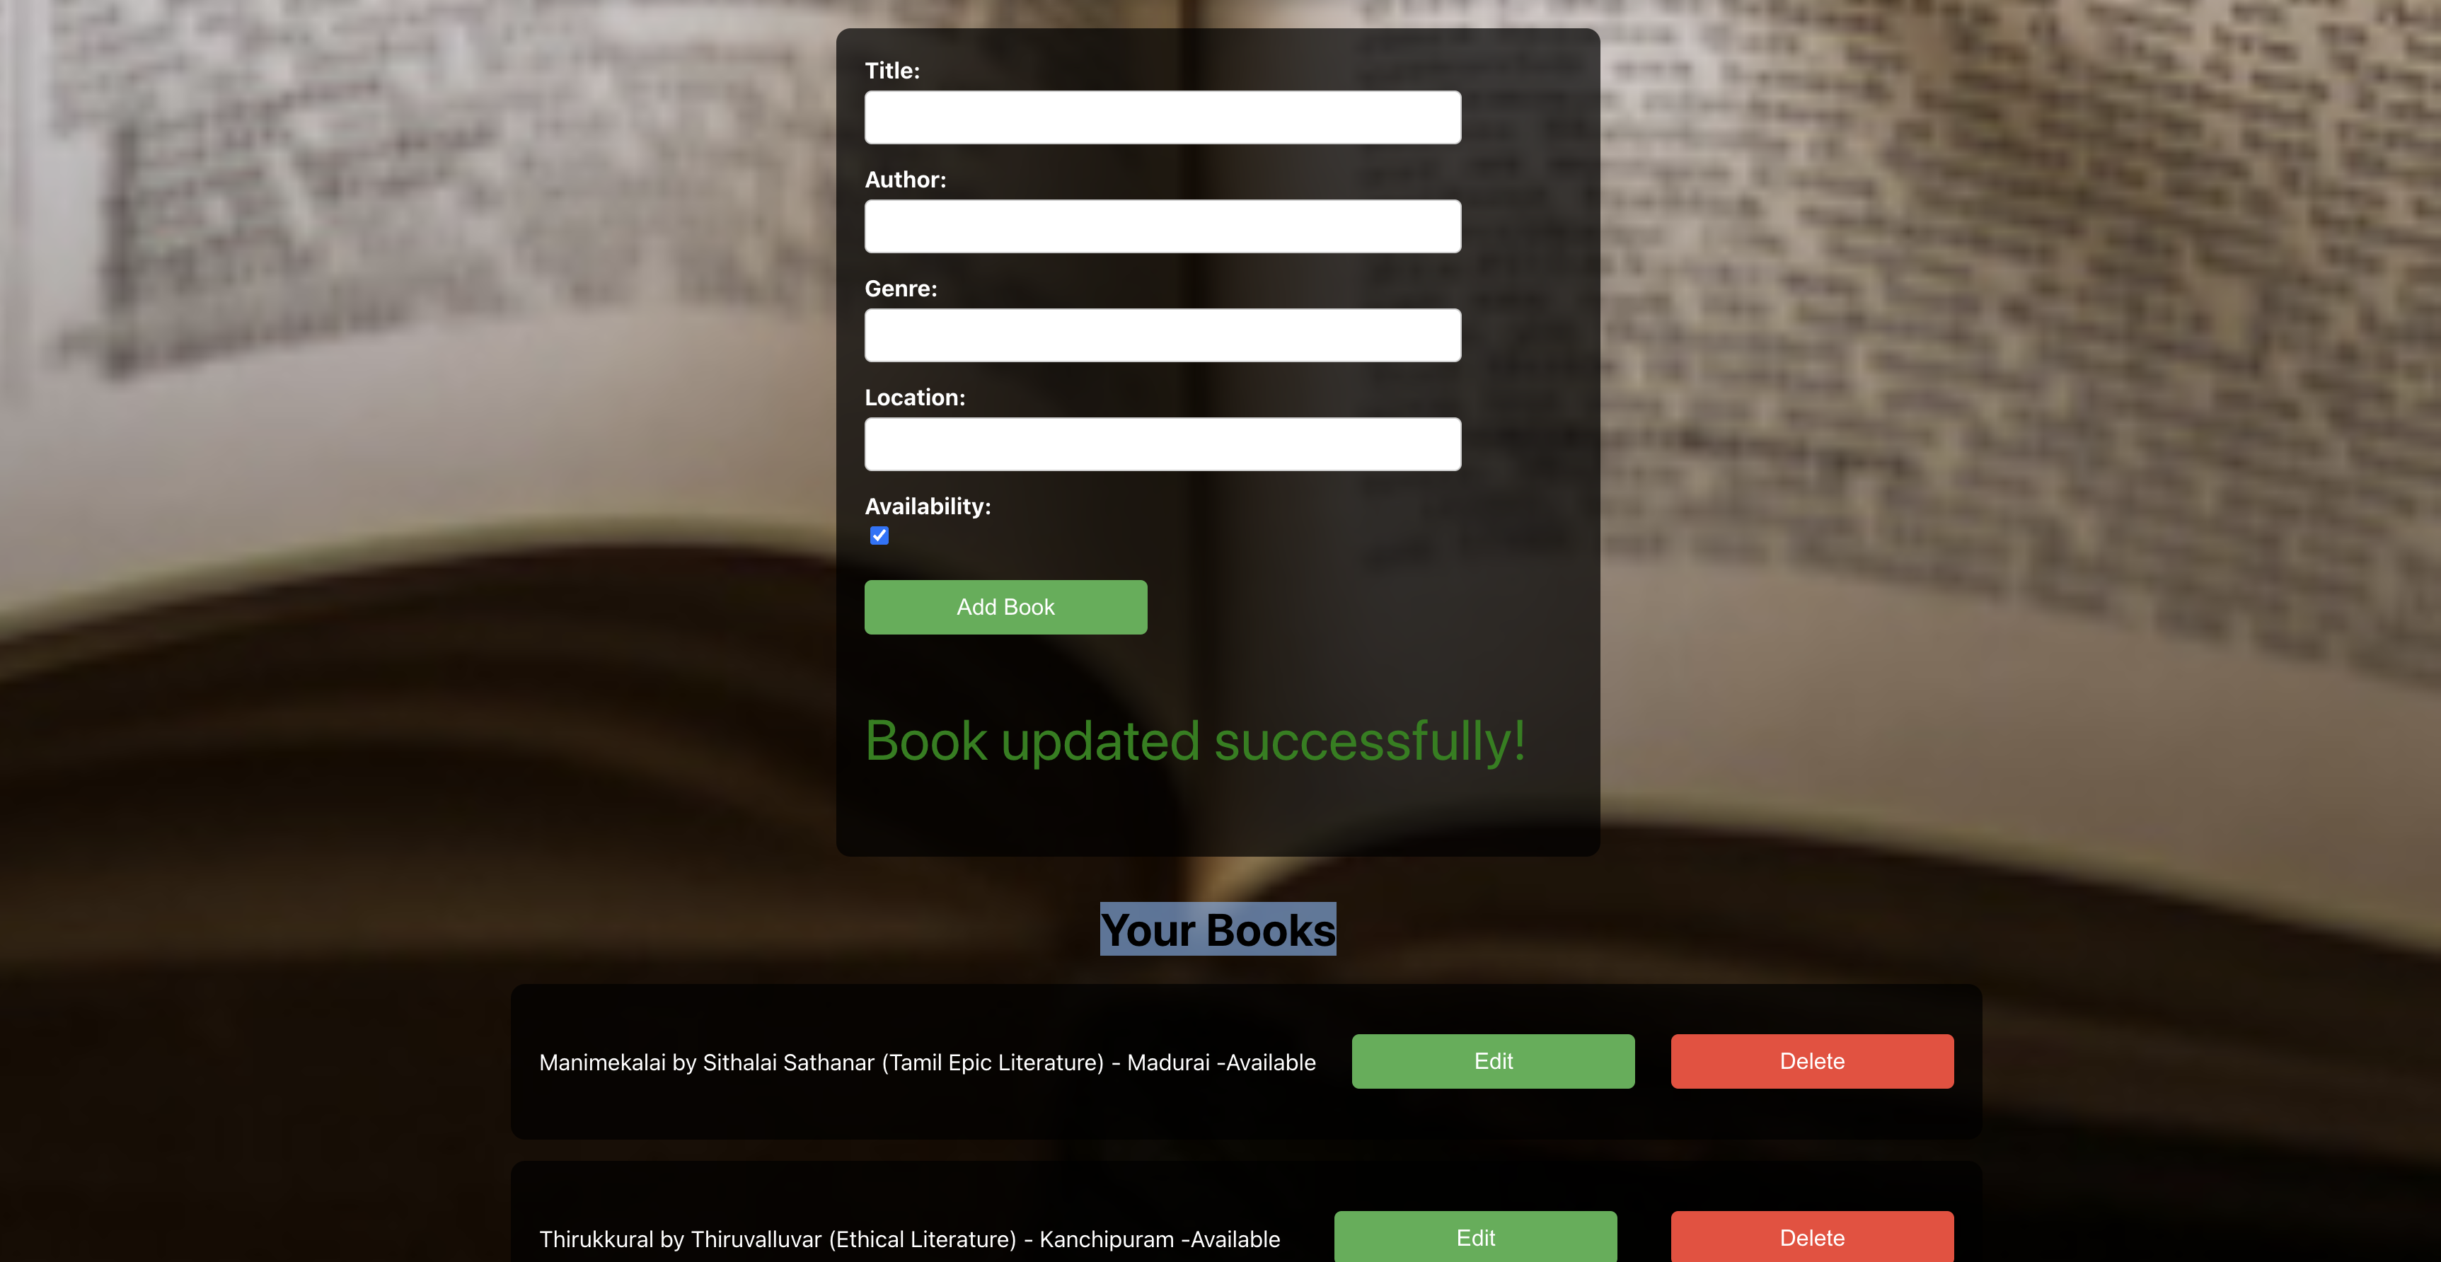
Edit Books

Slide 10
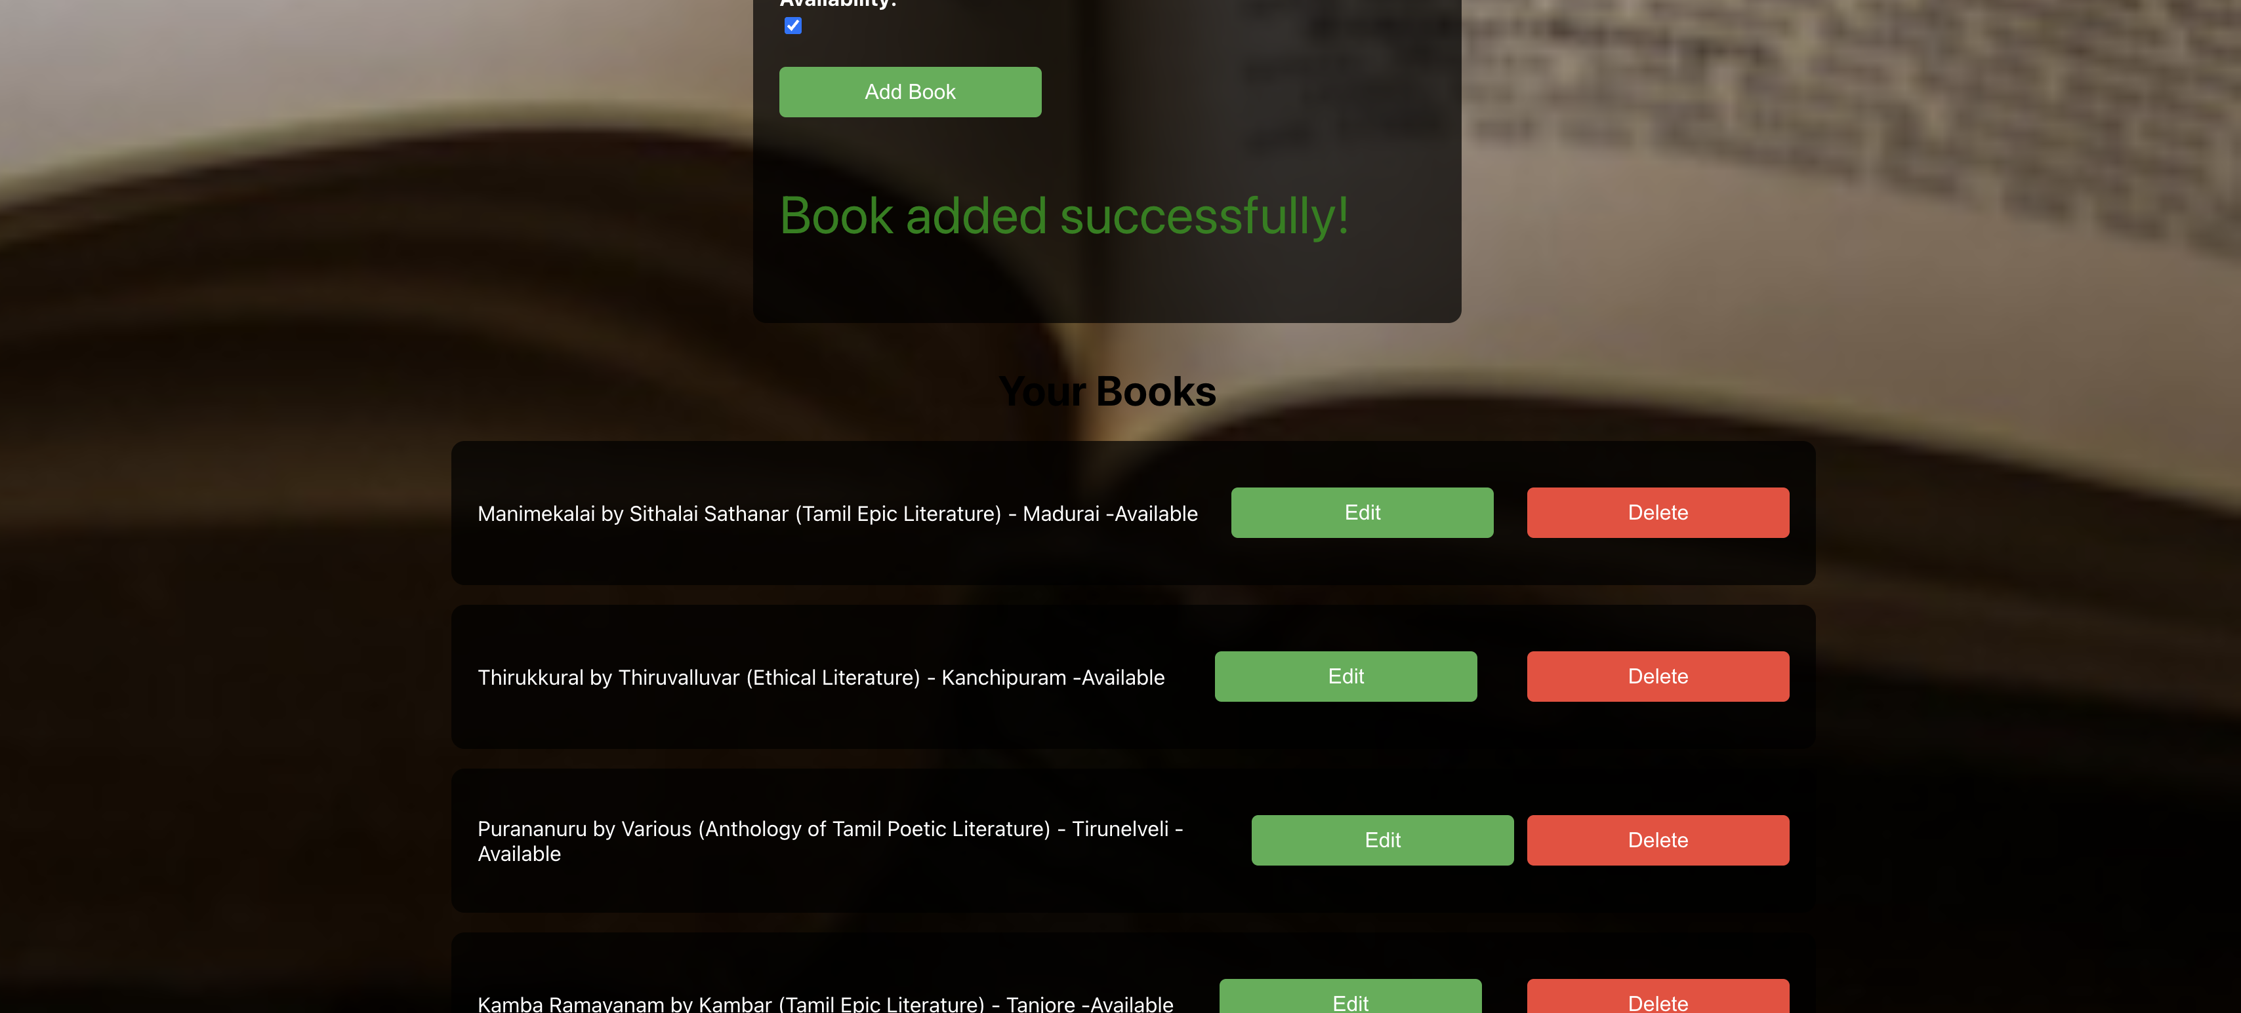
Add Book, shows under “Your books”

Slide 11
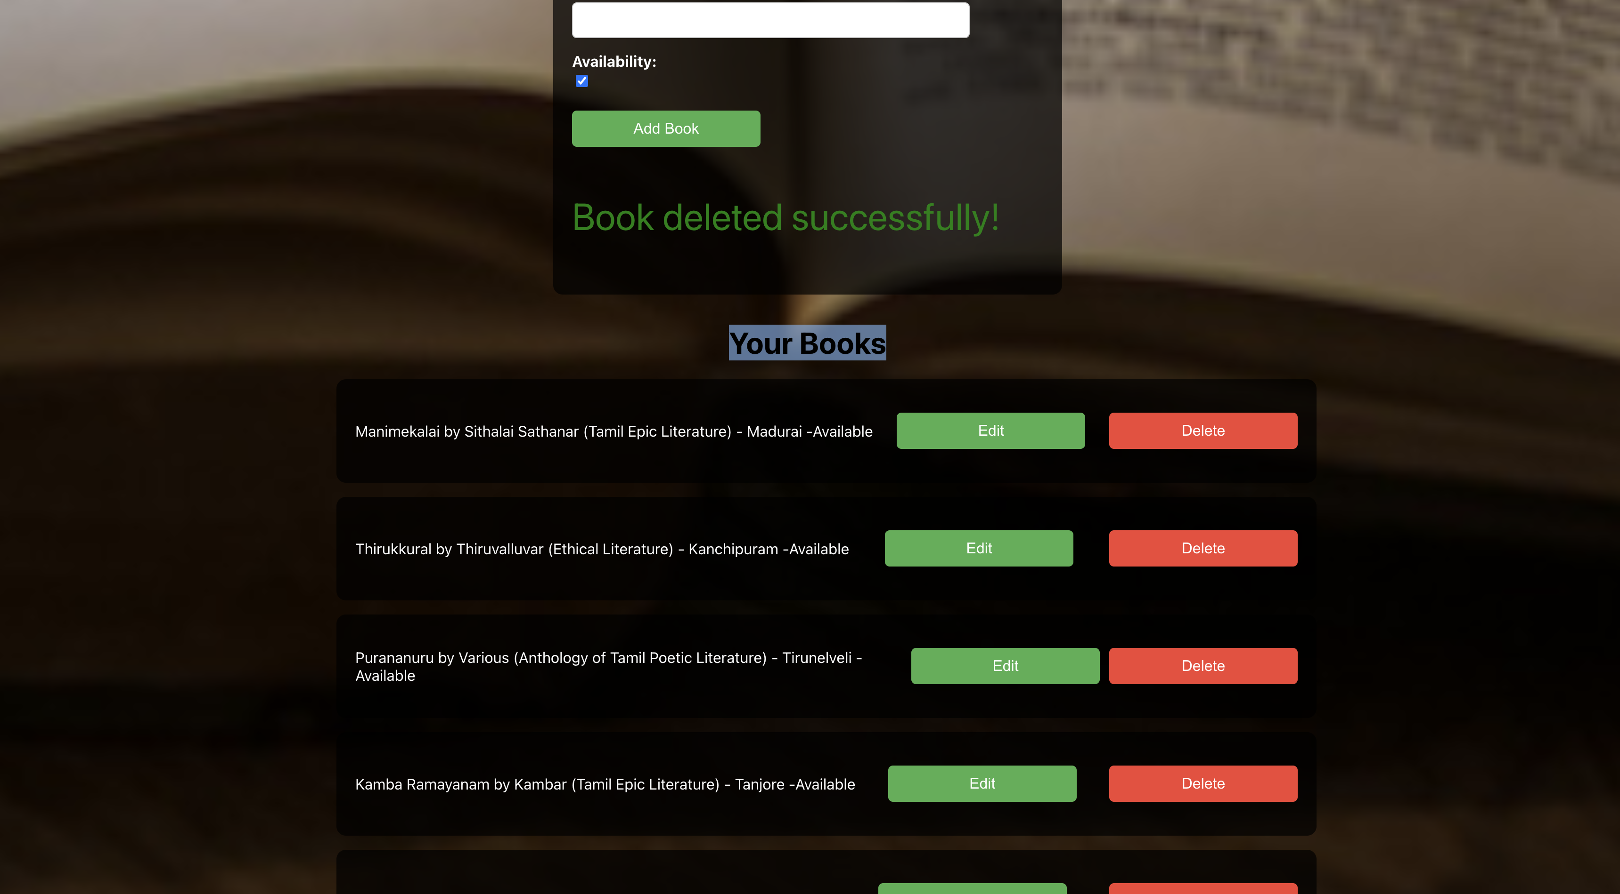
Delete Books

Slide 12
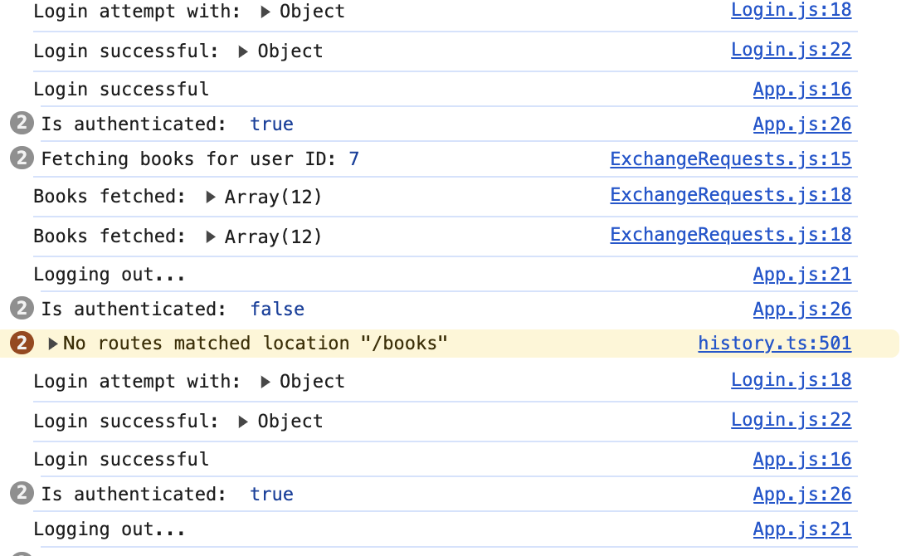
Logout functionality

Slide 13
service like Twilio API
WhatsApp requires an integration with an API to send messages. One common way to do this is by using a service like Twilio API, which offers WhatsApp messaging capabilities.
Here’s how you can approach this:
1. Choose a WhatsApp API Provider
To send WhatsApp messages, you’ll need to integrate with a WhatsApp messaging API. The most popular service for this is Twilio.
For simplicity, I’ll guide you on how to use Twilio API to send WhatsApp messages.
2. Sign up for Twilio and Get API Keys
Go to Twilio and sign up for an account.
After signing up, get your Account SID, Auth Token, and WhatsApp-enabled number from the Twilio console.

Slide 14
Twilio is a cloud communications company that provides APIs and SDKs to help developers and businesses add communication features to their applications:
Voice: Make and receive phone calls
Text: Send and receive text messages
Video: Add real-time video calling to applications
Chat: Add chat capabilities to applications
Email: Add email capabilities to applications
Authentication: Add authentication capabilities to applications

Slide 15
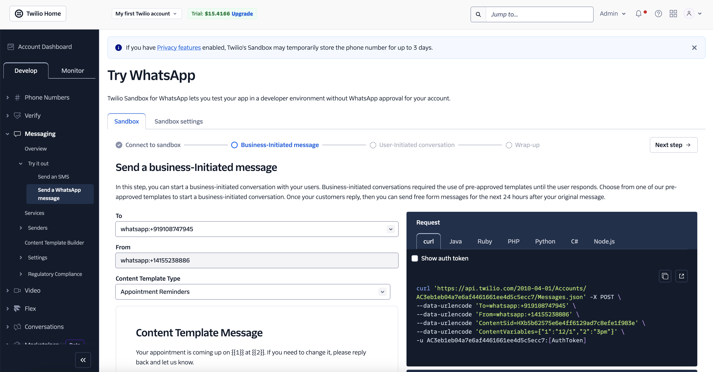
TWILIO SANDBOX MSG TEST:

Slide 16
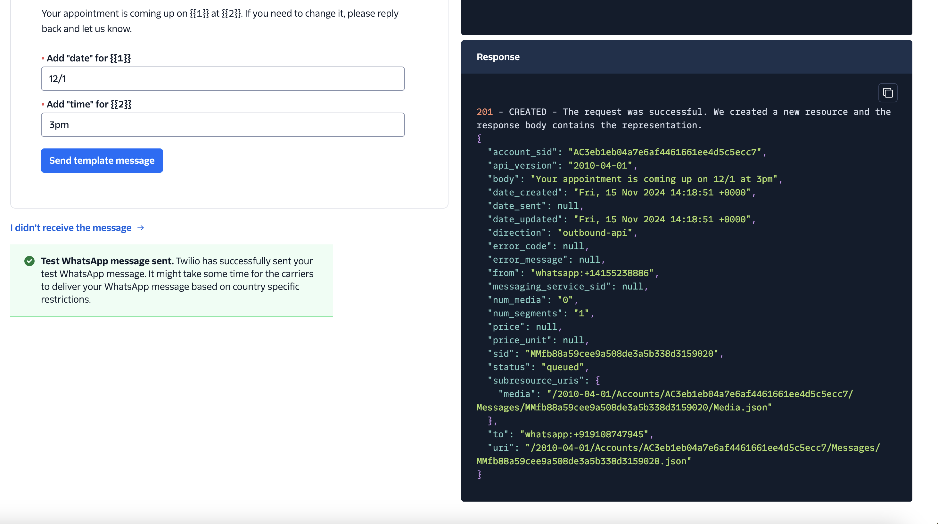
SUCCESS-TEST

Slide 17
Snapshots of API response in Postman

Slide 18
APPLICATION LOGS:
Z0044L9@THHM4G4PNY book-exchange-frontendv % ::1 - - [10/Nov/2024:15:50:53 +0000] "OPTIONS /auth/login HTTP/1.1" 204 0 "http://localhost:3001/" "Mozilla/5.0 (Macintosh; Intel Mac OS X 10_15_7) AppleWebKit/537.36 (KHTML, like Gecko) Chrome/127.0.0.0 Safari/537.36"
::1 - - [10/Nov/2024:15:50:53 +0000] "POST /auth/login HTTP/1.1" 200 66 "http://localhost:3001/" "Mozilla/5.0 (Macintosh; Intel Mac OS X 10_15_7) AppleWebKit/537.36 (KHTML, like Gecko) Chrome/127.0.0.0 Safari/537.36"
::1 - - [10/Nov/2024:15:50:53 +0000] "GET /api/books/1 HTTP/1.1" 304 - "http://localhost:3001/" "Mozilla/5.0 (Macintosh; Intel Mac OS X 10_15_7) AppleWebKit/537.36 (KHTML, like Gecko) Chrome/127.0.0.0 Safari/537.36"
::1 - - [10/Nov/2024:15:50:53 +0000] "GET /api/books/1 HTTP/1.1" 304 - "http://localhost:3001/" "Mozilla/5.0 (Macintosh; Intel Mac OS X 10_15_7) AppleWebKit/537.36 (KHTML, like Gecko) Chrome/127.0.0.0 Safari/537.36"
::1 - - [10/Nov/2024:15:50:54 +0000] "GET /api/books/other-users/7 HTTP/1.1" 304 - "http://localhost:3001/" "Mozilla/5.0 (Macintosh; Intel Mac OS X 10_15_7) AppleWebKit/537.36 (KHTML, like Gecko) Chrome/127.0.0.0 Safari/537.36"
::1 - - [10/Nov/2024:15:50:54 +0000] "GET /api/books/other-users/7 HTTP/1.1" 304 - "http://localhost:3001/" "Mozilla/5.0 (Macintosh; Intel Mac OS X 10_15_7) AppleWebKit/537.36 (KHTML, like Gecko) Chrome/127.0.0.0 Safari/537.36"
::1 - - [10/Nov/2024:15:50:56 +0000] "GET /api/books/1 HTTP/1.1" 304 - "http://localhost:3001/" "Mozilla/5.0 (Macintosh; Intel Mac OS X 10_15_7) AppleWebKit/537.36 (KHTML, like Gecko) Chrome/127.0.0.0 Safari/537.36"
::1 - - [10/Nov/2024:15:50:56 +0000] "GET /api/books/1 HTTP/1.1" 304 - "http://localhost:3001/" "Mozilla/5.0 (Macintosh; Intel Mac OS X 10_15_7) AppleWebKit/537.36 (KHTML, like Gecko) Chrome/127.0.0.0 Safari/537.36"
::1 - - [10/Nov/2024:15:51:00 +0000] "GET /api/books-search?title=&author=&genre=love&location=&availability= HTTP/1.1" 304 - "http://localhost:3001/" "Mozilla/5.0 (Macintosh; Intel Mac OS X 10_15_7) AppleWebKit/537.36 (KHTML, like Gecko) Chrome/127.0.0.0 Safari/537.36"
::1 - - [10/Nov/2024:15:51:20 +0000] "OPTIONS /api/books/14 HTTP/1.1" 204 0 "http://localhost:3001/" "Mozilla/5.0 (Macintosh; Intel Mac OS X 10_15_7) AppleWebKit/537.36 (KHTML, like Gecko) Chrome/127.0.0.0 Safari/537.36"
::1 - - [10/Nov/2024:15:51:20 +0000] "PUT /api/books/14 HTTP/1.1" 200 160 "http://localhost:3001/" "Mozilla/5.0 (Macintosh; Intel Mac OS X 10_15_7) AppleWebKit/537.36 (KHTML, like Gecko) Chrome/127.0.0.0 Safari/537.36"
::1 - - [10/Nov/2024:15:55:16 +0000] "OPTIONS /auth/login HTTP/1.1" 204 0 "http://localhost:3001/" "Mozilla/5.0 (Macintosh; Intel Mac OS X 10_15_7) AppleWebKit/537.36 (KHTML, like Gecko) Chrome/127.0.0.0 Safari/537.36"
::1 - - [10/Nov/2024:15:55:16 +0000] "POST /auth/login HTTP/1.1" 200 66 "http://localhost:3001/" "Mozilla/5.0 (Macintosh; Intel Mac OS X 10_15_7) AppleWebKit/537.36 (KHTML, like Gecko) Chrome/127.0.0.0 Safari/537.36"
::1 - - [10/Nov/2024:15:55:16 +0000] "GET /api/books/1 HTTP/1.1" 200 2002 "http://localhost:3001/" "Mozilla/5.0 (Macintosh; Intel Mac OS X 10_15_7) AppleWebKit/537.36 (KHTML, like Gecko) Chrome/127.0.0.0 Safari/537.36"
::1 - - [10/Nov/2024:15:55:16 +0000] "GET /api/books/1 HTTP/1.1" 304 - "http://localhost:3001/" "Mozilla/5.0 (Macintosh; Intel Mac OS X 10_15_7) AppleWebKit/537.36 (KHTML, like Gecko) Chrome/127.0.0.0 Safari/537.36"
::1 - - [10/Nov/2024:16:21:35 +0000] "GET /api/books-search?title=&author=&genre=tamil&location=&availability= HTTP/1.1" 200 1485 "http://localhost:3001/" "Mozilla/5.0 (Macintosh; Intel Mac OS X 10_15_7) AppleWebKit/537.36 (KHTML, like Gecko) Chrome/127.0.0.0 Safari/537.36"
::1 - - [10/Nov/2024:16:24:30 +0000] "OPTIONS /api/books/2 HTTP/1.1" 204 0 "http://localhost:3001/" "Mozilla/5.0 (Macintosh; Intel Mac OS X 10_15_7) AppleWebKit/537.36 (KHTML, like Gecko) Chrome/127.0.0.0 Safari/537.36"
::1 - - [10/Nov/2024:16:24:30 +0000] "PUT /api/books/2 HTTP/1.1" 200 184 "http://localhost:3001/" "Mozilla/5.0 (Macintosh; Intel Mac OS X 10_15_7) AppleWebKit/537.36 (KHTML, like Gecko) Chrome/127.0.0.0 Safari/537.36"
::1 - - [10/Nov/2024:16:27:05 +0000] "OPTIONS /api/books HTTP/1.1" 204 0 "http://localhost:3001/" "Mozilla/5.0 (Macintosh; Intel Mac OS X 10_15_7) AppleWebKit/537.36 (KHTML, like Gecko) Chrome/127.0.0.0 Safari/537.36"
::1 - - [10/Nov/2024:16:27:05 +0000] "POST /api/books HTTP/1.1" 201 161 "http://localhost:3001/" "Mozilla/5.0 (Macintosh; Intel Mac OS X 10_15_7) AppleWebKit/537.36 (KHTML, like Gecko) Chrome/127.0.0.0 Safari/537.36"
::1 - - [10/Nov/2024:16:28:08 +0000] "OPTIONS /api/books/20 HTTP/1.1" 204 0 "http://localhost:3001/" "Mozilla/5.0 (Macintosh; Intel Mac OS X 10_15_7) AppleWebKit/537.36 (KHTML, like Gecko) Chrome/127.0.0.0 Safari/537.36"
::1 - - [10/Nov/2024:16:28:08 +0000] "DELETE /api/books/20 HTTP/1.1" 204 - "http://localhost:3001/" "Mozilla/5.0 (Macintosh; Intel Mac OS X 10_15_7) AppleWebKit/537.36 (KHTML, like Gecko) Chrome/127.0.0.0 Safari/537.36"

Slide 19
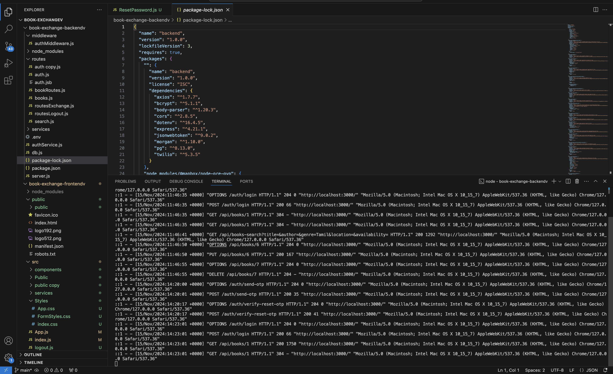

Slide 20
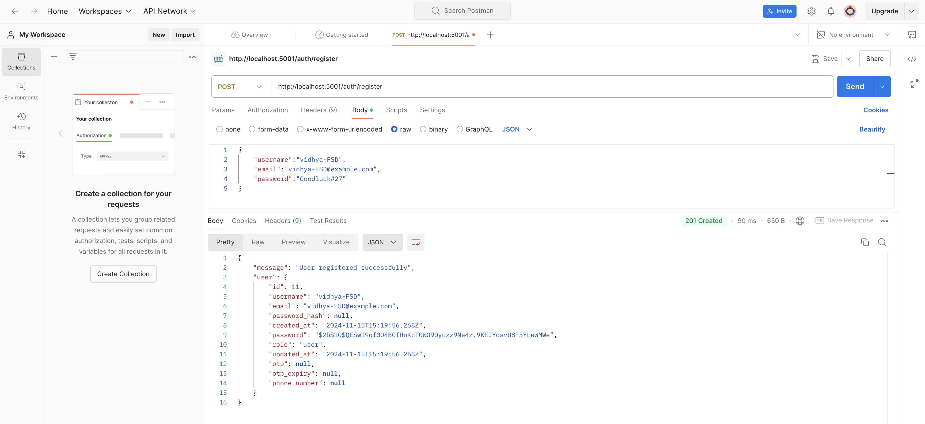
Register

Slide 21
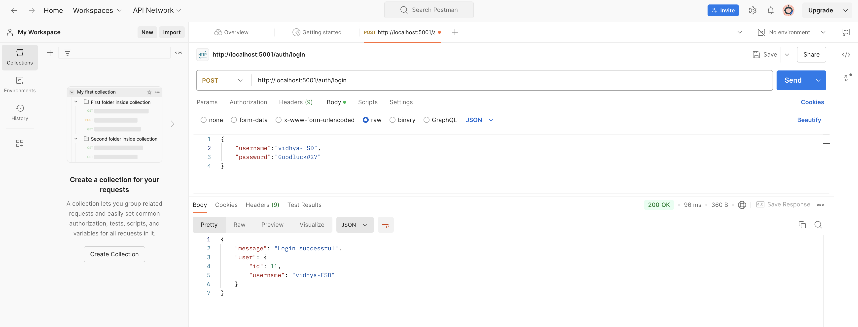
Login

Slide 22
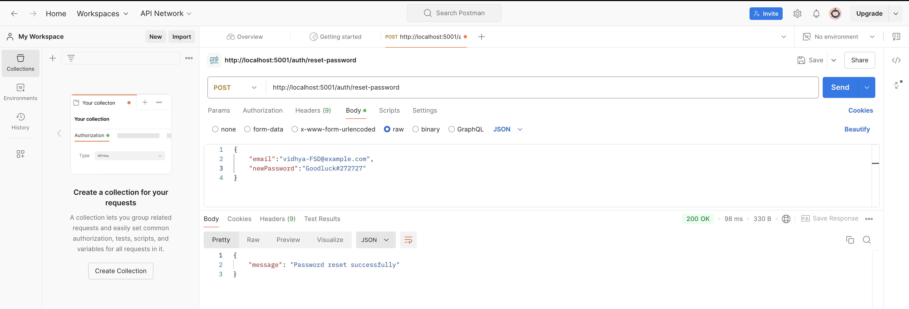
Password Reset

Slide 23
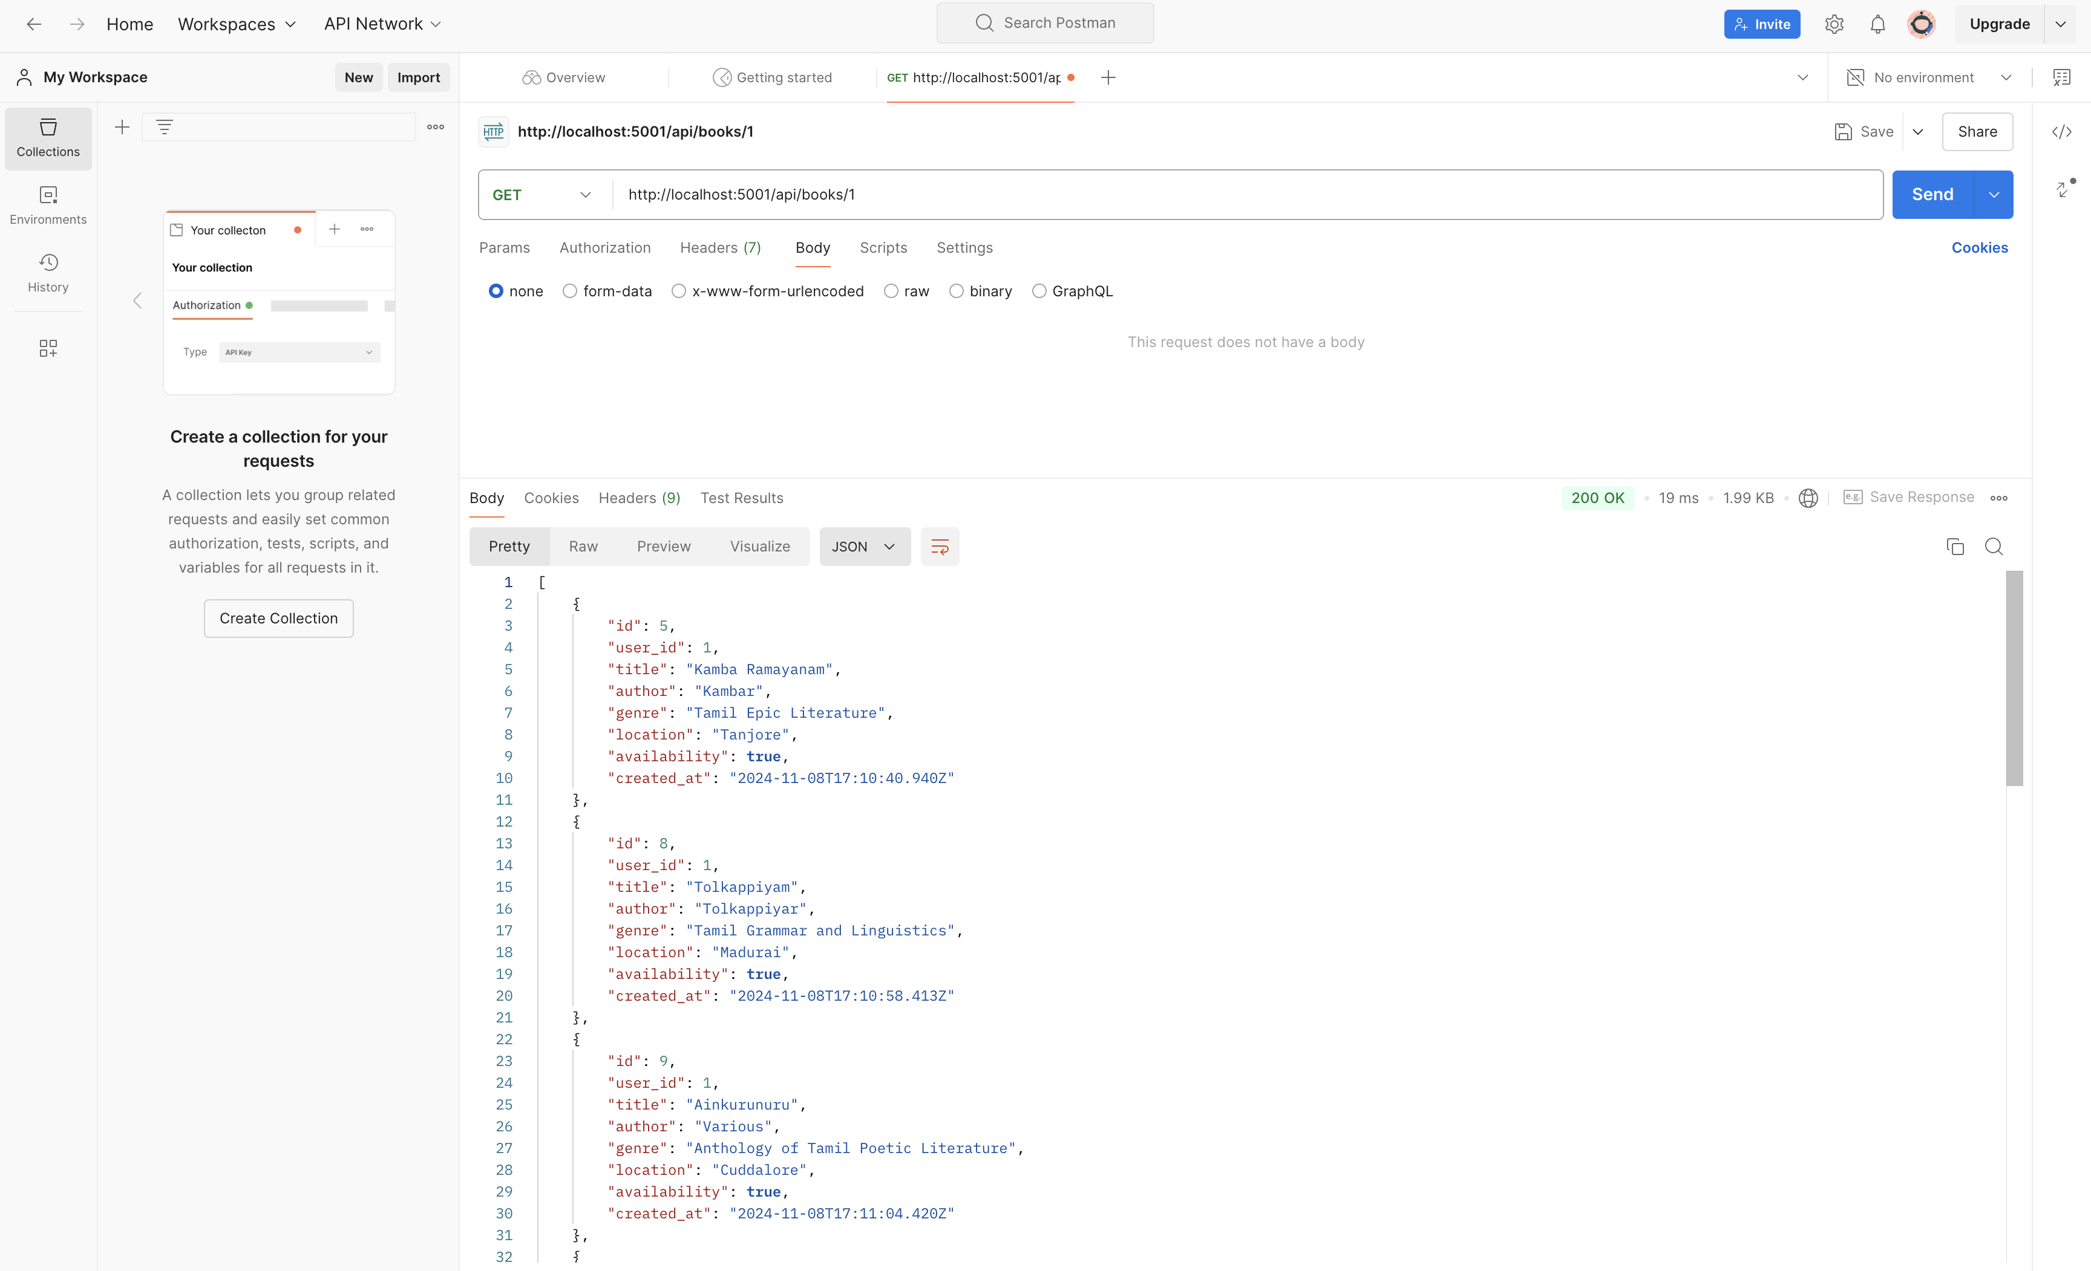
Get Books of Userid “1”

Slide 24

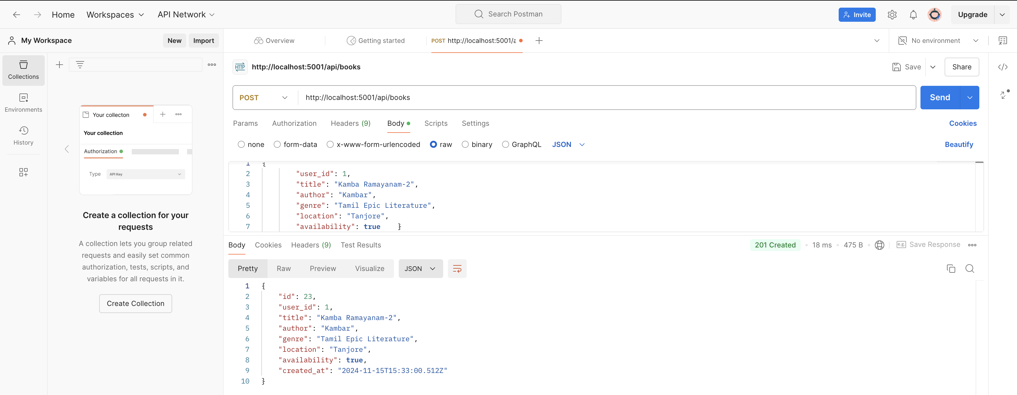
Add a book

Slide 25

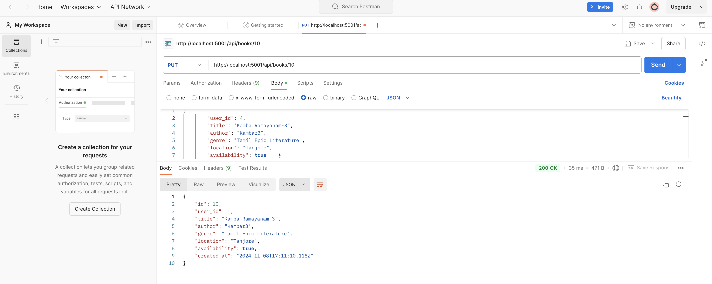
Update a book

Slide 26
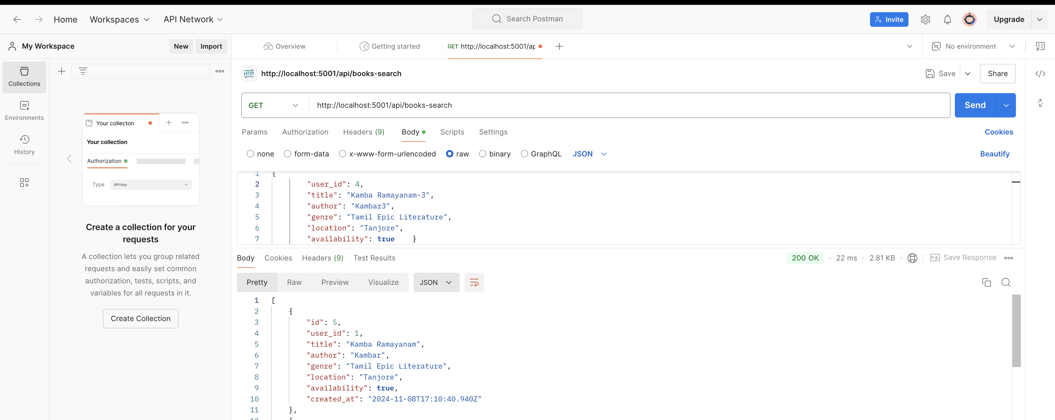
Search for a book

Slide 27
GIT HUB Link
https://github.com/vidhy27/BOOK_EXCHANGE_PLATFORM

Slide 28

Thank you

